Slide 1

Machine Learning
Classification
Pramote Kuacharoen

Slide 2
Classification
One of the main instances of supervised learning
Goal – to learn a general rule that correctly maps the observations
These are called features

Slide 3
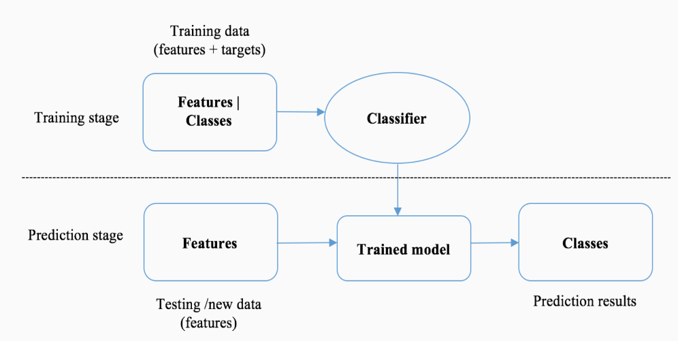
A Trained Classification Model

Slide 4
Categories of Classification
Binary classification
Multiclass classification
Multi-label classification

Slide 5
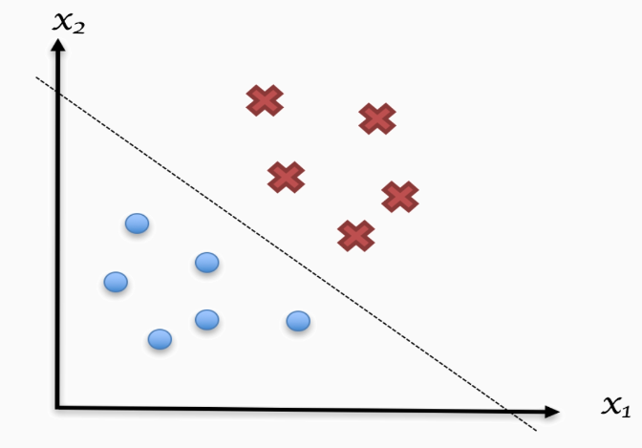
Binary Classification
Classify observation into one of the two possible classes
Examples
Email spam filtering
Customer churn prediction
Marketing and advertising industry
Medical field

Slide 6
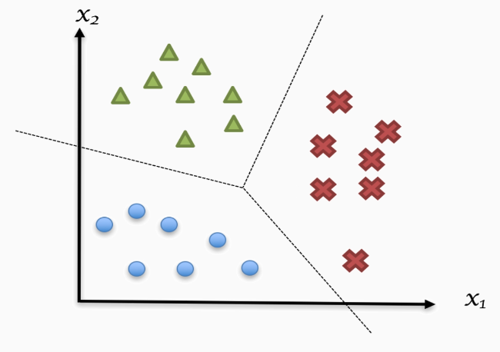
Multiclass Classification
Also called multinomial classification
More than two classes
Example
Hand writing classification

Slide 7
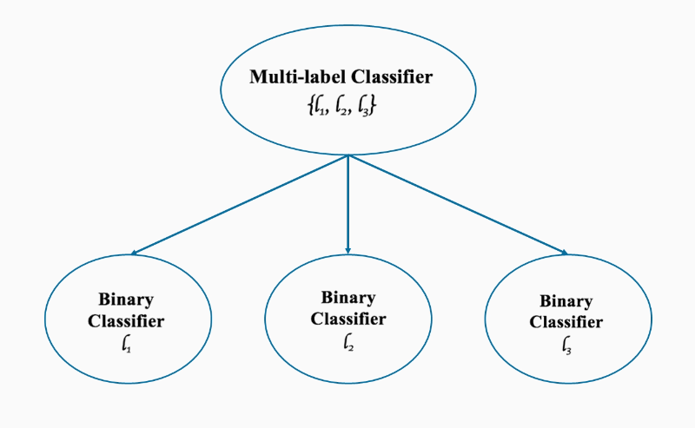
Multi-label Classification
Target classes are disjointed
Example
Picture that captures a sea and sunset
Can simultaneously belong to both conceptual scenes
Image of cat dog – binary cases
One fruit among others – orange, apple, banana in multiclass cases
Adventure films
Combined with other genres
Fantasy, science fiction, horror, and drama
Protein function classification
New sentiment analysis
Classification algorithms are used to identify new sentiment
Provides a significant signal to trading in stock markets
Named-Entity recognition (NER)
Difficult to realize
Phrases of definitive categories
Names of persons, companies, geographic locations, dates and times, quantities, monetary values

Slide 8
Algorithms for Classification
Linear Classifiers
Support Vector Machines (SVM)
Logistic Regression
Naïve Bayes (NB)
Boosted Trees
Decision Trees
Neural Networks
Random Forest
Nearest Neighbor

Slide 9
Question?
Insert Image

